Slide 1
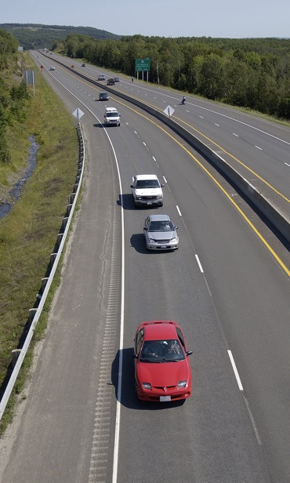
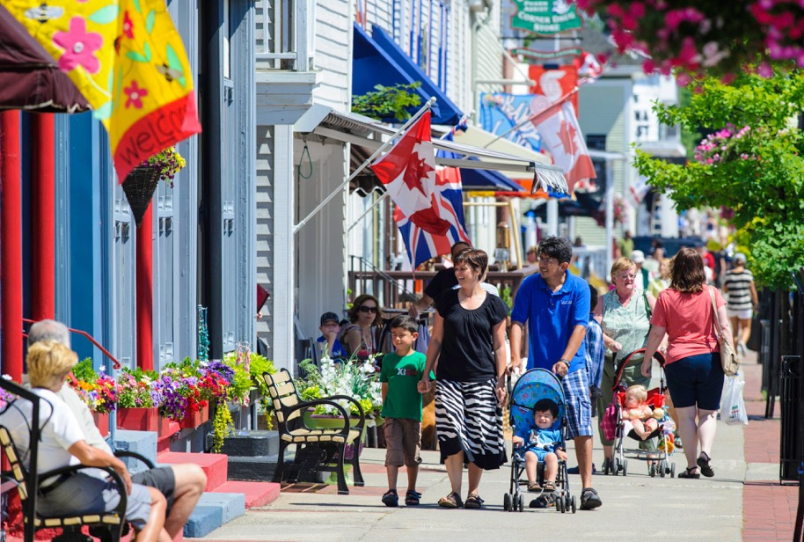
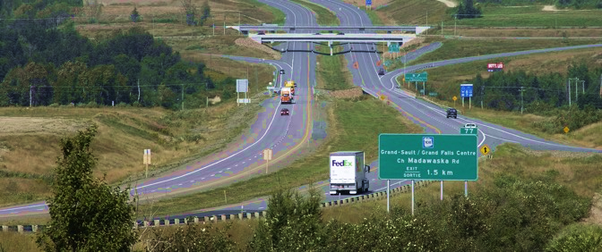
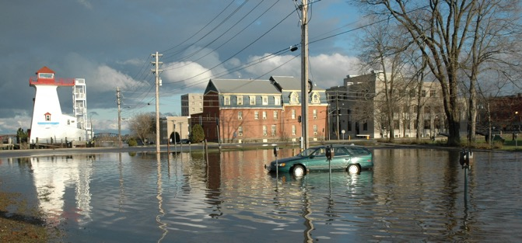
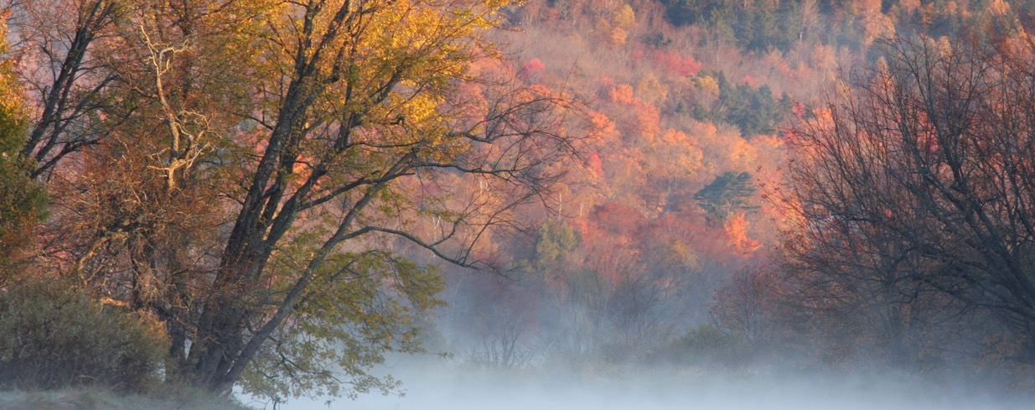
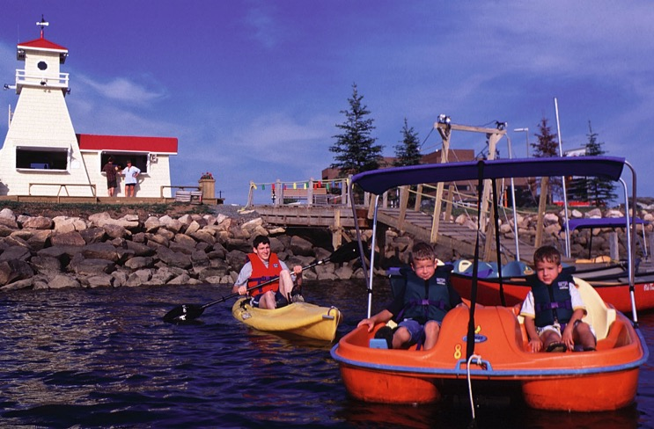
Welcome!

Slide 2
Introductions

Slide 3
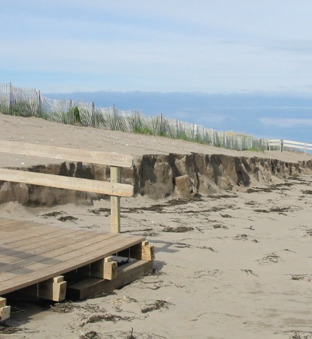
Objectives for Today
Share what is possible with Statements of Provincial Interest
Learn from experiences elsewhere
Establish priorities and identify next steps

Slide 4
Acknowledgements

Slide 5
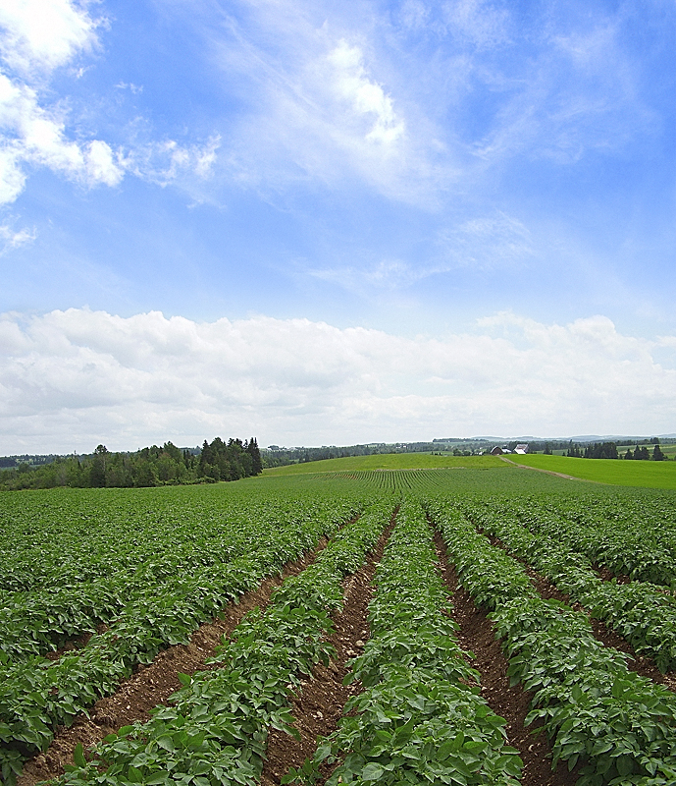
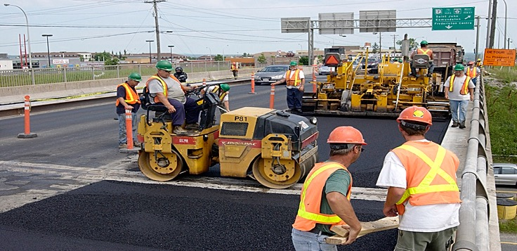
Background

Slide 6
Future Focus Futur
New Brunswick Association of Planners
Building a Business Case for Modernization of Planning Legislation
A Grassroots Approach
February 1, 2018

Slide 7
Environmental Trust Fund
Three phases
Discussion paper
Public engagement
Symposium
Notes:
Opportunity to support government in changing legislation
Provide the background and rationale for why it is a good idea

Slide 8
Phase 1 - Discussion Paper
Legislative review
Economic basis
Agriculture
Community and Culture
Land use Development
Natural Environment
Statements of Provincial Interest
Notes:
Initially envisaged one phase
Work quite extensive, resulting in multiple phases
First phase included a legislative review – look at all jurisdictions across Canada
Then a review and analysis of currents issues facing the province from a land use perspective
Then look at some examples of use of spi and cost savings

Slide 9
Legislative Review
13 Canadian jurisdictions
10 - some form of land use planning
Common policy statements:
Flood risk
Settlement
Transportation

Slide 10
The Province – Context
383 communities of varying sizes and administrations
>90% forested land - 46% Crown Owned
>60% of the land mass without planning
50-50 Rural - Urban
Aging population
Notes:
So what does this mean?
People can do what they want?
Our question to everyone in the room is, “wouldn’t it make sense to develop plans which allow for land use which is feasible, affordable, sustainable over the longer term?”
Not really a good idea
An oft cited example is new subdivision development abutting active farms with smelly livestock

Slide 11
Agriculture
Development pressures – loss of farmland
Out of province corporate ownership
Food security
Notes:
Small scale farms are gradually declining in number, being bought out by large multi-national agri-businesses or being sold for suburban housing developments. The effect of this is far reaching in that the agri-businesses are shipping their product out of the province with limited investment in the local economy. Further, there are significant land use conflicts with major residential developments in close proximity to farms. Food security is becoming an issue where most rely on food being imported into the province.
New Brunswick has many natural environment attributes and is renowned for its rivers, forests and coastline. Protection of these features is uncoordinated to the point that there has been a gradual erosion of value of the natural environment. Of particular concern is the coast line where development pressures continue without significant enforceable control.
There are many different communities in New Brunswick ranging from small rural settlements to larger cities. Each carries a sense of identity, which in effect is the driving force behind their continued existence. With almost half of the population of New Brunswick residing in rural communities, the importance of community facilities cannot be understated. Unplanned growth in the urban/rural fringe undermines the viability of communities by impacting the growth and tax base of municipalities.
Unplanned growth at the urban/rural fringe also results in increasing financial burden on taxpayers in order to provide community services such as police, fire, ambulance, school busing and utilities. There is overwhelming support that development of any kind should not be allowed anywhere. The belief that growth at any cost is good for the economy is no longer sustainable.

Slide 12
Community and Culture
Urban sprawl
Healthy communities
Notes:
Unplanned low density growth in the urban/rural fringe can undermine the viability of communities by impacting the growth and tax base of municipalities.
Cost of health care due to obesity – building strong and sustainable communities is critical
Supporting existing communities to become self governing with respect to land use is a viable alternative to continued urban sprawl
Provincial projects which directly affect the ability of a municipality to provide infrastructure services cannot continue in isolation.

Slide 13
Land use Development
Settlement patterns – long term effects of unplanned growth
Sustainability of “growth at any cost”
Matching appropriate uses with appropriate locations
Notes:
Unplanned growth at the urban/rural fringe also results in increasing financial burden on taxpayers in order to provide community services such as police, fire, ambulance, school busing and utilities. There is overwhelming support that development of any kind should not be allowed anywhere

Slide 14
Natural Environment
Flood risk – developments in flood plain
Coastal area protection – 5500 km of coastline
Effects of climate change – stormwater management
Notes:
Lack of coordinated policy to protect the natural environment
Crown land is almost half the province – different rules apply, ie no planning
Tourism – responsible for parks – bringing in Resource Management Plans – great idea, coordination is required however to ensure effectiveness and minimize duplication
Costs of responding to climate change

Slide 15
A new approach
For every site there is an ideal use. For every use there is an ideal site.
John Ormsbee Simonds – Landscape Architect

Slide 16
Provincial Statements of Interest
Resiliency (Climate Change Adaptation)
Flood Risk Reduction
Health and the Built Environment
Coastal Development
Infrastructure and Transportation Planning

Slide 17
Resiliency (Climate Change Adaptation)

Slide 18
Flood Risk Reduction

Slide 19
Health and the Built Environment

Slide 20
Health and the Built Environment

Slide 21
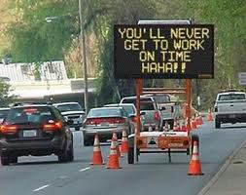
Health and the Built Environment

Slide 22
Coastal Development

Slide 23
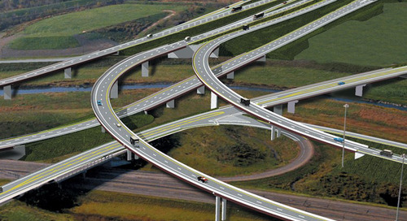
Infrastructure and Transportation Planning

Slide 24
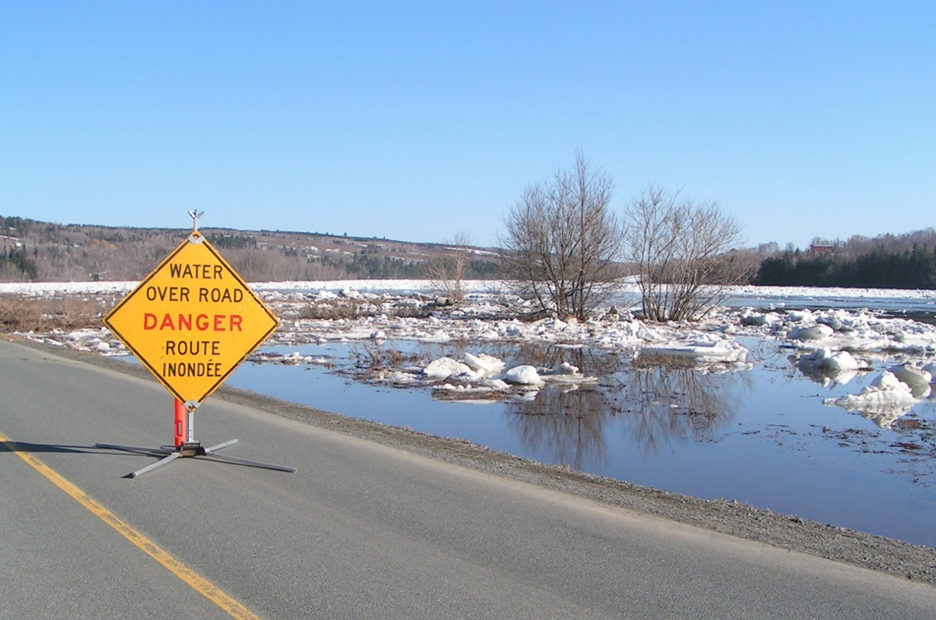
Infrastructure and Transportation Planning

Slide 25
Phase 2 - Public Engagement
Province wide – 4 sessions
Open Discussion – Idea Exchange
Support for SPI

