Slide 1
Statements of Provincial Interest: The Manitoba Experience New Brunswick Association of Planners Future Focus Symposium Fredericton, NB February 1, 2018
Grant Melnychuk MCIP, RPP Manager of Provincial Planning Manitoba Municipal Relations

Slide 2
Overview:
Manitoba
the Province and the Planning Framework
Manitoba’s Provincial Land Use Policies
Scope, application, summary of content
General Observations

Slide 4
History of Planning in Manitoba
1916 – The Town Planning Act
Enabled local land use planning
1949 – Metropolitan Planning Act
Established regional planning body for Winnipeg and surrounding area
1960 – The Planning Service Act
Formalized the provision of provincial planning services across Manitoba
1964 – The Planning Act
Enabled municipalities to plan with neighbours (planning districts)
1976 – The Planning Act
Introduced requirement for subdivision approval
Introduced Provincial Land Use Policies (1980)
2006 – The Planning Act
Required municipalities to adopt development plans and zoning by-laws
New Provincial Land Use Policies (2011)

Slide 5
Provincial Land Use Policies (PLUPs)
Manitoba’s ‘provincial interest statements’ in land use and development
Adopted by Regulation – first Introduced in 1980
Rewritten in 1994 to incorporate Principles of Sustainable Development
Amended in 2005 to incorporate policies and setbacks for siting of livestock operations
Rewritten in 2011 to modernize and strengthen policy content
Serve as the policy framework for municipalities and the province when preparing, reviewing and approving local development plan by-laws

Slide 6
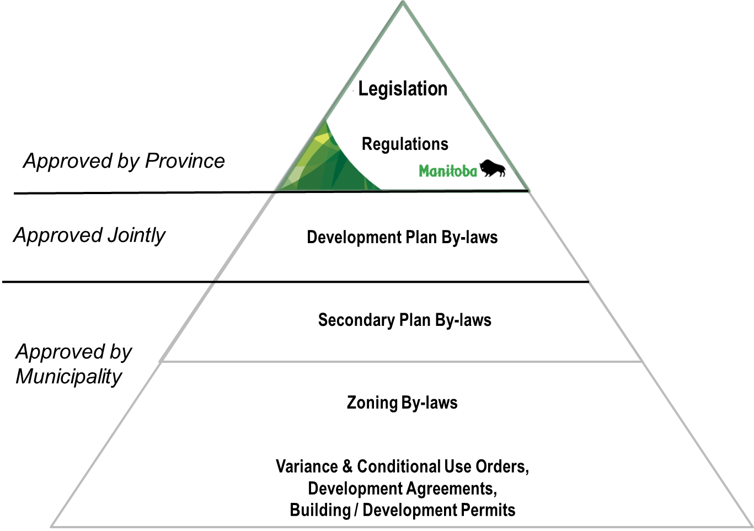
Manitoba’s Planning Framework

Slide 7
Provincial Land Use Policies: Structure, Scope and Application
Nine policy areas, each with:
Statement of provincial interest
Statement of policy goals
Series of land use policies
http://web2.gov.mb.ca/laws/regs/current/081.11.pdf
List the background studies that should be done to guide the development plan preparation.
PLUPs applied more diligently in high growth areas; with flexibility in areas experiencing slow growth or decline – intended to be applied to reflect local circumstances

Slide 8
Provincial Land Use Policies: Nine Policy Areas
General Development
Settlement Areas
Agriculture
Natural Lands, Renewable Resources, Heritage & Recreation
Water
Infrastructure
Transportation
Mineral Resources
Capital Region

Slide 9
Provincial Land Use Policies: 1. General Development
Provides general policy direction to all land uses and development – regardless of type, location or scale.
Four sections with policies built on the fundamentals of sound planning:
Protecting people, property & investment
Ensuring compatibility between uses
Integrating public services
Promoting sustainable development.

Slide 10
Provincial Land Use Policies: 2. Settlement Areas
Applies to urban, rural and cottage development.
Encourages a range of housing types to accommodate different needs and incomes.
Encourages communities to develop strong urban cores and to prioritize intensification and infill before greenfield expansion.
Encourages urban expansion away from prime agricultural lands and agricultural operations (when possible).

Slide 11
Provincial Land Use Policies: 3. Agriculture
Strongly promotes the need to protect agricultural land for food production and to protect agricultural operations from encroachment by incompatible land uses.
Identifies the limited circumstances when agricultural lands can be subdivided on a single lot basis.
Requires that all plans include policies identifying where livestock development can occur and to what scale.

Slide 12
Provincial Land Use Policies: 4. Renewable Resources, Heritage & Recreation
Encourages conservation and protection of heritage resources and ecologically sensitive areas.
Promotes the sustainable use of renewable resources in an environmentally sound manner.
Encourages future recreational uses to be appropriately planned and sited and the enhancement of existing urban forests and greenspaces.

Slide 13
Provincial Land Use Policies: 5. Water
Directs new development away from lands subject to flooding and erosion and requires adequate flood protection (1 in 100 year flood level) in areas susceptible to flooding.
Discourages development that alters wetlands (unless it is for the purpose of flood mitigation).
Promotes surface water protection via development setbacks the and the efficient and sustainable use of potable groundwater

Slide 14
Provincial Land Use Policies: 6. Infrastructure
Aims to integrate land use and infrastructure planning and to ensure that full life-cycle infrastructure costs are factored in planning decisions.
Encourages the preparation of local drinking water and wastewater management plans to guide the development plan review process (required in the Capital Region).
Encourages the intensification of areas with piped services and discourages new development reliant on onsite services (wells and septic fields).

Slide 15
Provincial Land Use Policies: 7. Transportation
Encourages integration and connectivity of the transportation systems.
Promotes planning for all modes of transport including transit and active transportation.
Discourages development that jeopardizes the safety and efficiency of the provincial highway network (e.g. closely spaced driveways, poorly aligned intersections, etc.)

Slide 16
Provincial Land Use Policies: 8. Mineral Resources
Development plans should identify lands containing high mineral and aggregate resources and protect these resources from conflicting surface land uses that could impact exploration or extraction.

Slide 17
Provincial Land Use Policies: 9. Capital Region
New policy area introduced in 2011 PLUPs to recognize the importance of the Capital Region as home to over two-thirds of Manitobans.
Encourages regional and inter-municipal strategies and cooperation to address growth and development pressures and servicing needs.
Aims to identify, protect and maximize the potential of the Region’s key economic assets (inter-modal transportation facilities, 24 hour international airport, clustered cultural, educational and medical facilities).

Slide 18
Provincial Land Use Policies: Subsequent Resource Guides
Planning for Agriculture
Transportation Planning
Planning for Protection of Riparian Areas
Planning for Climate Change – Mitigation
Planning for Climate Change – Adaptation
Guide for School Site Planning
Manitoba Manual for Conservation Subdivision Design
Planning Guidelines for Secondary Suites

Slide 19
What’s working?
The province recognizes the importance of land use planning
All municipalities have development plans and zoning by-laws that generally reflect the provincial interest.
The quality of local plans and the local planning capacity has been improving over time.
Challenges?
Developing (and applying) a ‘one size fits all’ policy framework
Regulation vs. Policy
Policies can become dated.

Slide 20
Thank you!

Slide 21
Panel Discussion

Slide 22
To what extent do you agree with the underlying principles that are the basis for creating the five SPIs?

Slide 23
To what extent do you agree with the underlying principles that are the basis for creating an SPI for Climate Change Adaptation?
1. Climate change threatens established systems and presents a risk to long- term economic stability and growth in New Brunswick.
Strongly disagree
Disagree
Neither agree nor disagree
Agree
Strongly agree

Slide 24
To what extent do you agree with the underlying principles that are the basis for creating an SPI for Climate Change Adaptation?
2. Preventing and adapting to climate change presents opportunities to develop new industries and to discover efficiencies for existing systems and industries.
Strongly disagree
Disagree
Neither agree nor disagree
Agree
Strongly agree

Slide 25
To what extent do you agree with the underlying principles that are the basis for creating an SPI for Floodplain Development?
3. Climate change is increasing the frequency and severity of flooding in New Brunswick.
Strongly disagree
Disagree
Neither agree nor disagree
Agree
Strongly agree

Slide 26
To what extent do you agree with the underlying principles that are the basis for creating an SPI for Floodplain Development?
4. Development and infrastructure in floodplains can displace floodwaters and worsen flooding.
Strongly disagree
Disagree
Neither agree nor disagree
Agree
Strongly agree

Slide 27
To what extent do you agree with the underlying principles that are the basis for creating an SPI for Floodplain Development?
5. Responding to flood damage creates significant public and private costs.
Strongly disagree
Disagree
Neither agree nor disagree
Agree
Strongly agree

Slide 28
To what extent do you agree with the underlying principles that are the basis for creating an SPI for Health and the Built Environment ?
6. The design of communities and the location of land uses in relation to each other affects residents’ ability to practice a healthy lifestyle.
Strongly disagree
Disagree
Neither agree nor disagree
Agree
Strongly agree

Slide 29
To what extent do you agree with the underlying principles that are the basis for creating an SPI for Health and the Built Environment ?
7. Ensuring the health of the population is a priority of New Brunswick.
Strongly disagree
Disagree
Neither agree nor disagree
Agree
Strongly agree

Slide 30
To what extent do you agree with the underlying principles that are the basis for creating an SPI for Health and the Built Environment ?
8. Healthy built environments support physical, mental, and social health and can have significant economic benefits.
Strongly disagree
Disagree
Neither agree nor disagree
Agree
Strongly agree

Slide 31
To what extent do you agree with the underlying principles that are the basis for creating an SPI for Coastal Development?
9. Coastal environments are dynamic systems where natural processes reshape the land on relatively short time frames.
Strongly disagree
Disagree
Neither agree nor disagree
Agree
Strongly agree

Slide 32
To what extent do you agree with the underlying principles that are the basis for creating an SPI for Coastal Development?
10. Significant levels of human development and infrastructure in New Brunswick are located in coastal areas.
Strongly disagree
Disagree
Neither agree nor disagree
Agree
Strongly agree

Slide 33
To what extent do you agree with the underlying principles that are the basis for creating an SPI for Coastal Development?
11. Climate change is expected to increase sea levels and the intensity of coastal storms, putting people and property at risk.
Strongly disagree
Disagree
Neither agree nor disagree
Agree
Strongly agree

Slide 34
To what extent do you agree with the underlying principles that are the basis for creating an SPI for Infrastructure Investment and Transportation Planning?
12. Effective infrastructure and transportation networks are crucial to a functioning province.
Strongly disagree
Disagree
Neither agree nor disagree
Agree
Strongly agree

Slide 35
To what extent do you agree with the underlying principles that are the basis for creating an SPI for Infrastructure Investment and Transportation Planning?
13. All levels of government have made significant investments in providing existing infrastructure.
Strongly disagree
Disagree
Neither agree nor disagree
Agree
Strongly agree

Slide 36
To what extent do you agree with this underlying principle that is the basis for creating an SPI for Infrastructure Investment and Transportation Planning?
14. Uncoordinated development uses infrastructure inefficiently and leads to additional financial costs for infrastructure.
Strongly disagree
Disagree
Neither agree nor disagree
Agree
Strongly agree

Slide 37
To what extent do you agree with the fundamental intention of the SPIs?

Slide 38
To what extent do you agree with the fundamental intention of the SPI on Climate Change Adaptation?
15. It is in the interest the Province of New Brunswick to prepare for, and become resilient to, the impacts of climate change and reduce its greenhouse emissions while sustaining economic growth.
Strongly disagree
Disagree
Neither agree nor disagree
Agree
Strongly agree

Slide 39
To what extent do you agree with the fundamental intention of the SPI on Floodplain Development?
16. It is in the interest of the Province of New Brunswick to control land uses and activities in flood plain areas in a manner that protects residents and properties, ensuring that environmental degradation and remedial costs are minimized, and that development is curtailed in locations where site conditions may pose a danger to public health and safety or result in property damage.
Strongly disagree
Disagree
Neither agree nor disagree
Agree
Strongly agree

Slide 40
To what extent do you agree with the fundamental intention of the SPI on Health and the Built Environment?
17. It is in the interest of the Province to improve the health and well-being of all New Brunswickers through the development of resilient communities by fostering land use decisions that positively influence public health outcomes.
Strongly disagree
Disagree
Neither agree nor disagree
Agree
Strongly agree

Slide 41
To what extent do you agree with the fundamental intention of the SPI for Coastal Development?
18. It is in the interest of the Province of New Brunswick to manage coastal areas to reduce impacts to coastal features, reduce the likelihood of threats to personal safety, maintain ecosystem components such as flora and fauna and minimize the cost of maintenance of public infrastructure.
Strongly disagree
Disagree
Neither agree nor disagree
Agree
Strongly agree

Slide 42
To what extent do you agree with the fundamental intention of the SPI for Infrastructure Investment and Transportation Planning?
19. It is in the interest of the Province of New Brunswick to provide, maintain and manage a safe, reliable and efficient road network and to promote efficient and sustainable water and wastewater systems in support of provincial economic and social development objectives.
Strongly disagree
Disagree
Neither agree nor disagree
Agree
Strongly agree

Slide 43
What is the relative priority of one SPI over another?

Slide 44
20. Please rank the SPIs in order of priority
Climate Change Adaptation
Coastal Development
Floodplain Development
Health and the Built Environment
Infrastructure Investment and Transportation Planning

